Slide 1

Find VA Forms - Search Product Guide
Making it easier for Veterans and others to find the right application to apply for benefits and other services.
VA.gov/find-forms

Slide 2
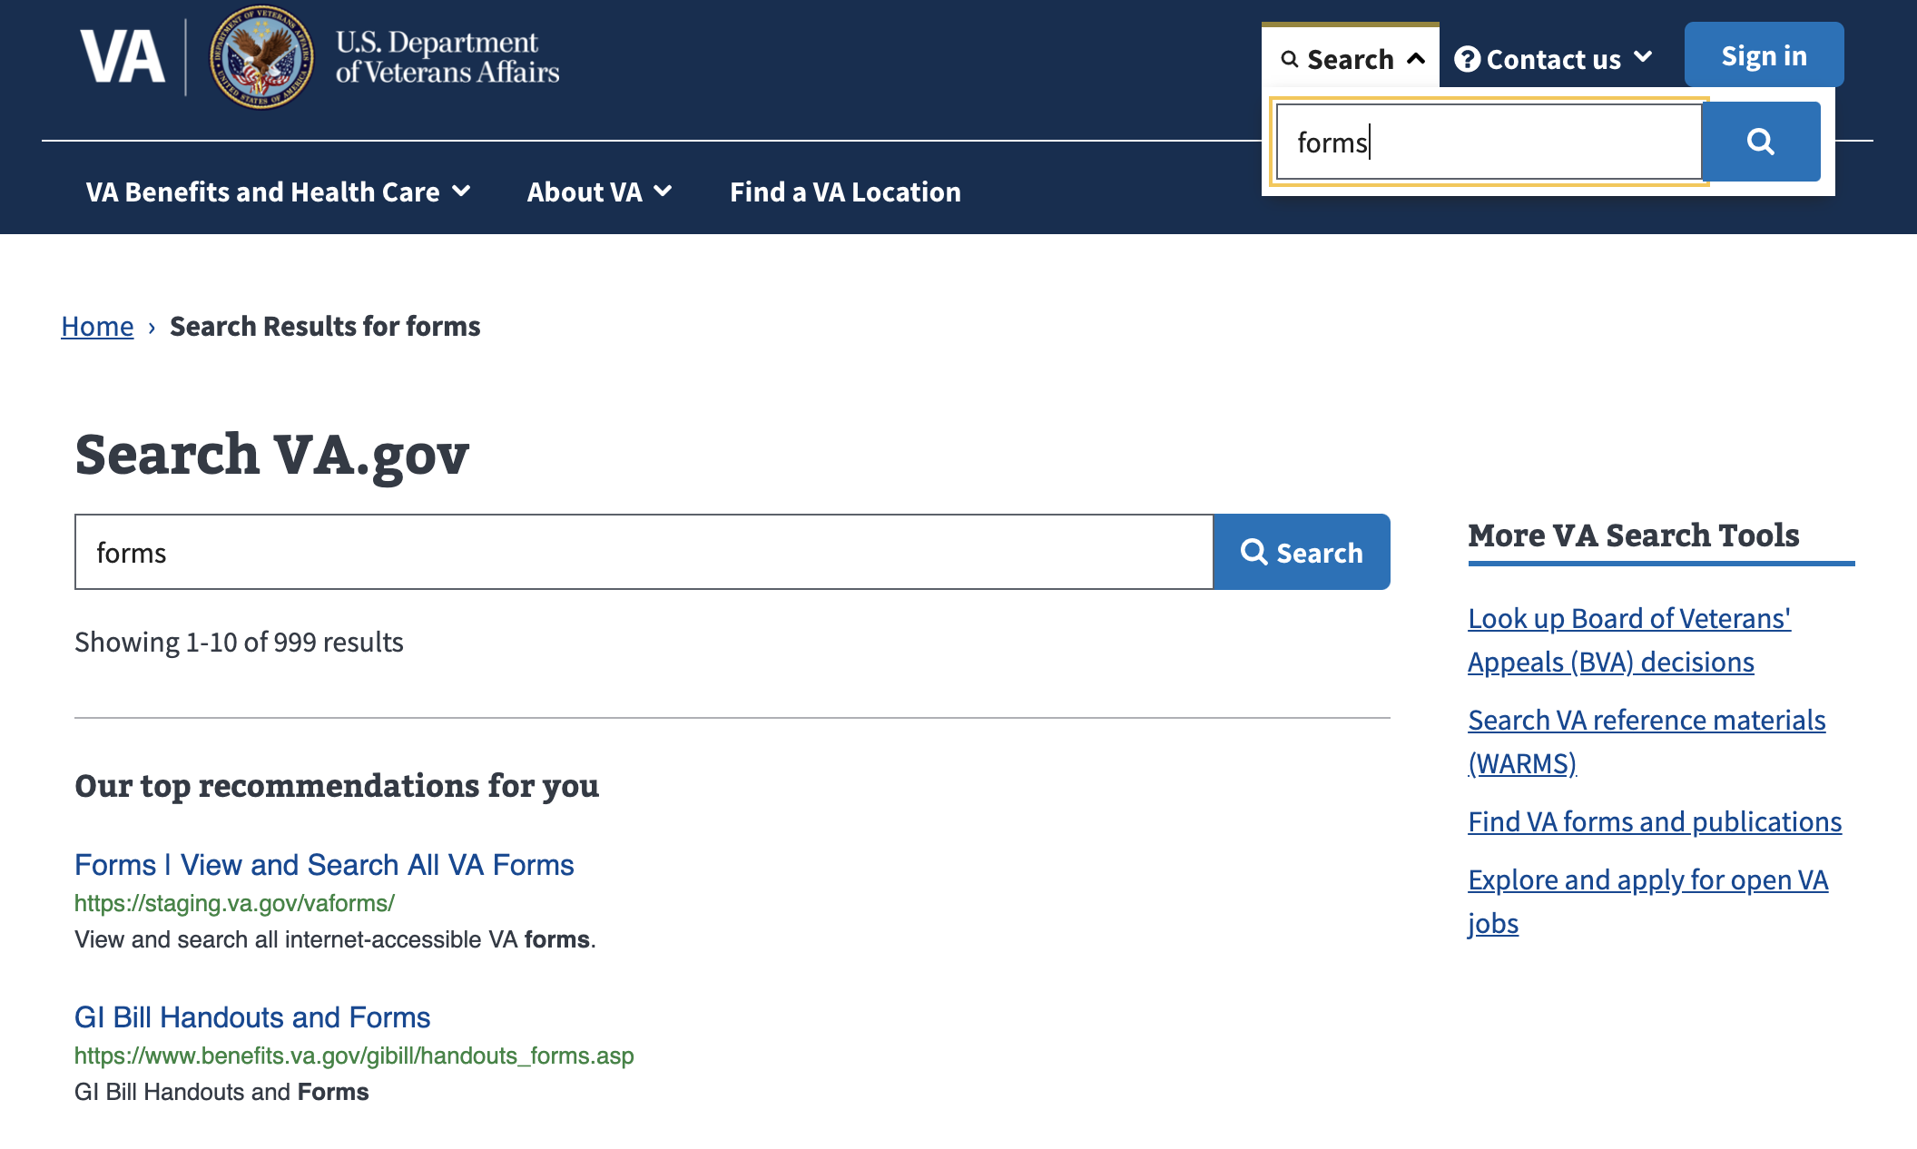
Navigating to Find VA Forms - Search
Find VA Forms - Search Product Guide
Search for “forms” from VA.gov on-site search
Top Recommendation includes link to Find VA Forms - Search

Slide 3
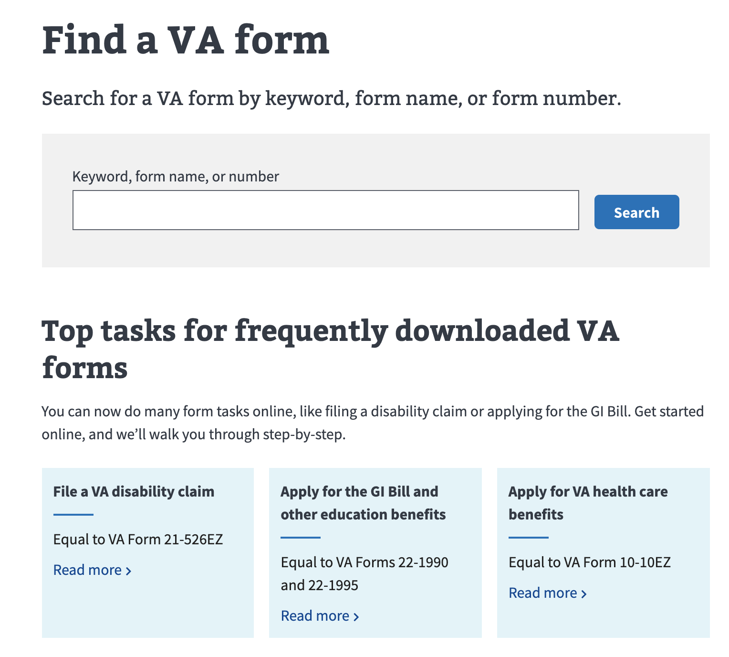
Search for VA forms: va.gov/find-forms
Find VA Forms - Search Product Guide

Slide 4
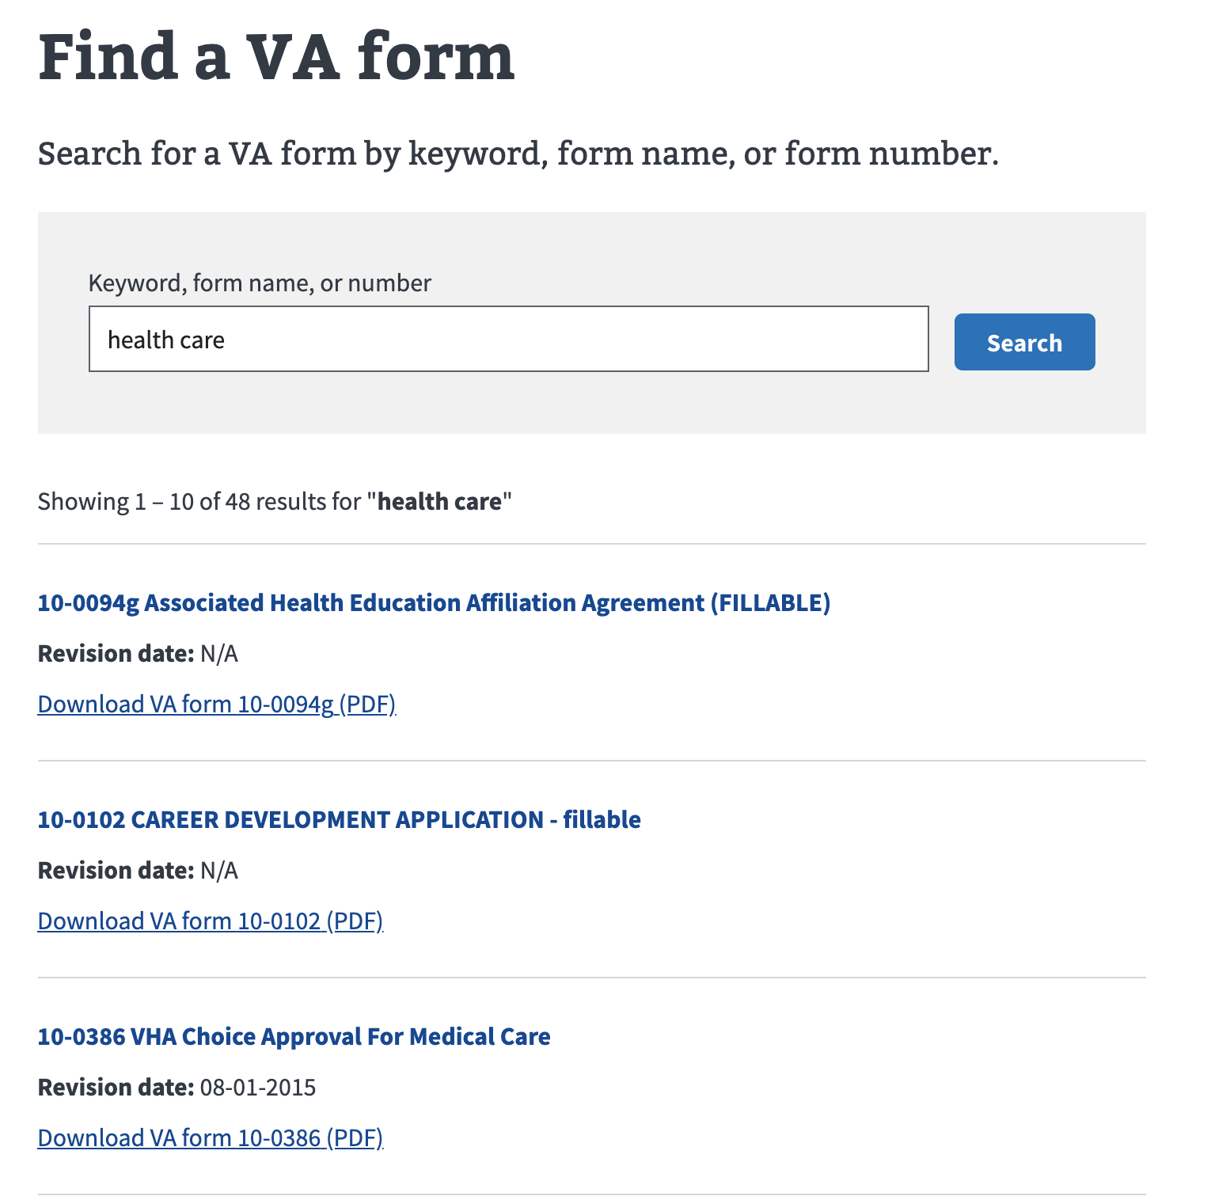
Download VA Form PDFs
Find VA Forms - Search Product Guide

Slide 5
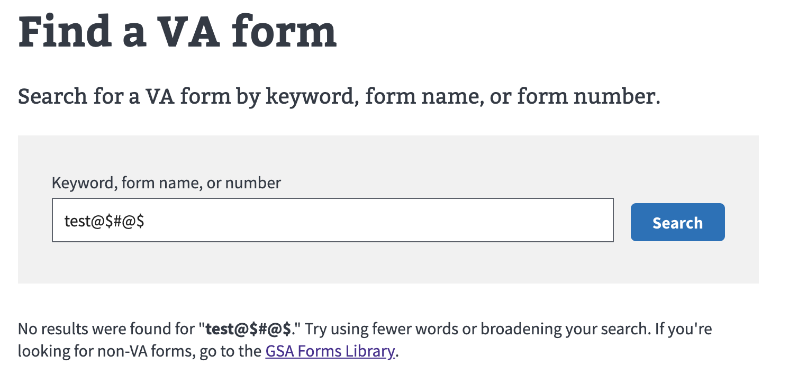
No Results - find more from GSA Forms Library
Find VA Forms - Search Product Guide

Slide 6
Quickly navigate to top tasks
Find VA Forms - Search Product Guide

Slide 7
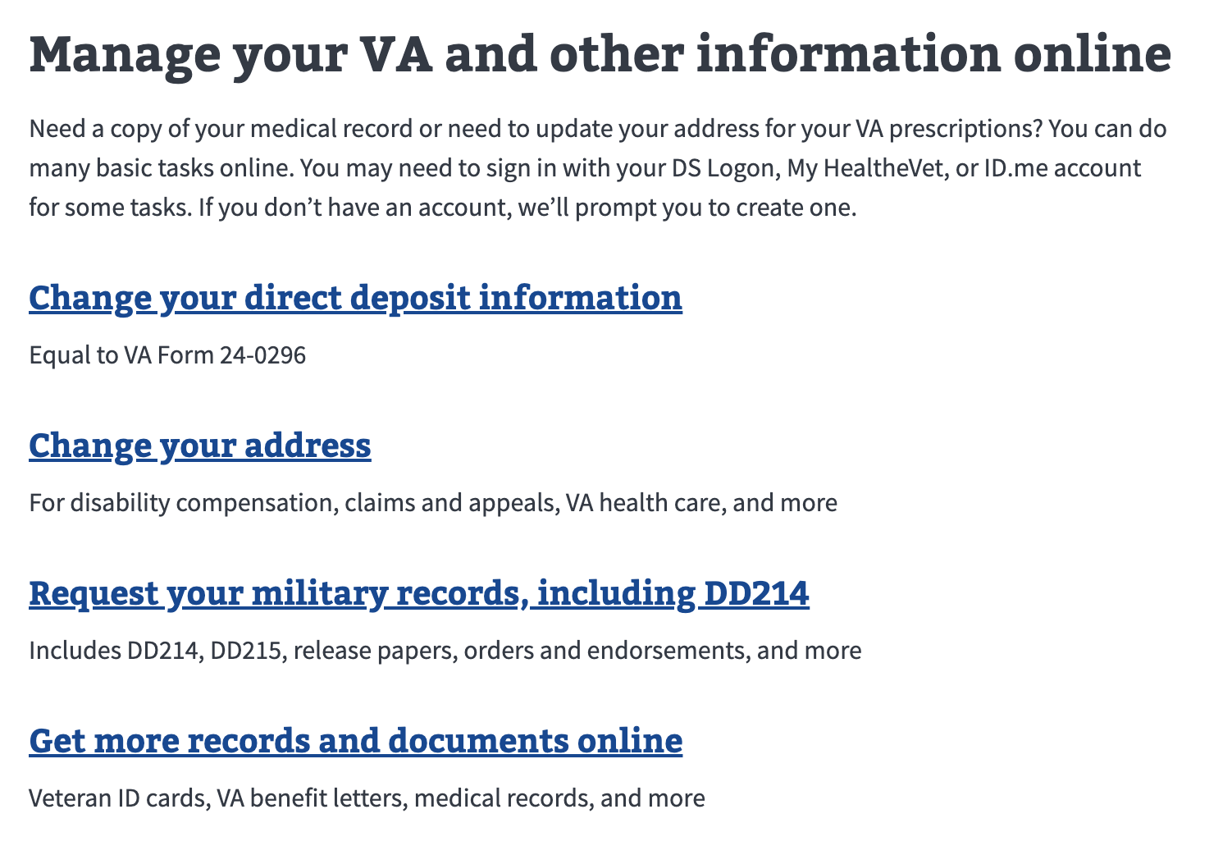
Manage personal profile information
Find VA Forms - Search Product Guide

Slide 8
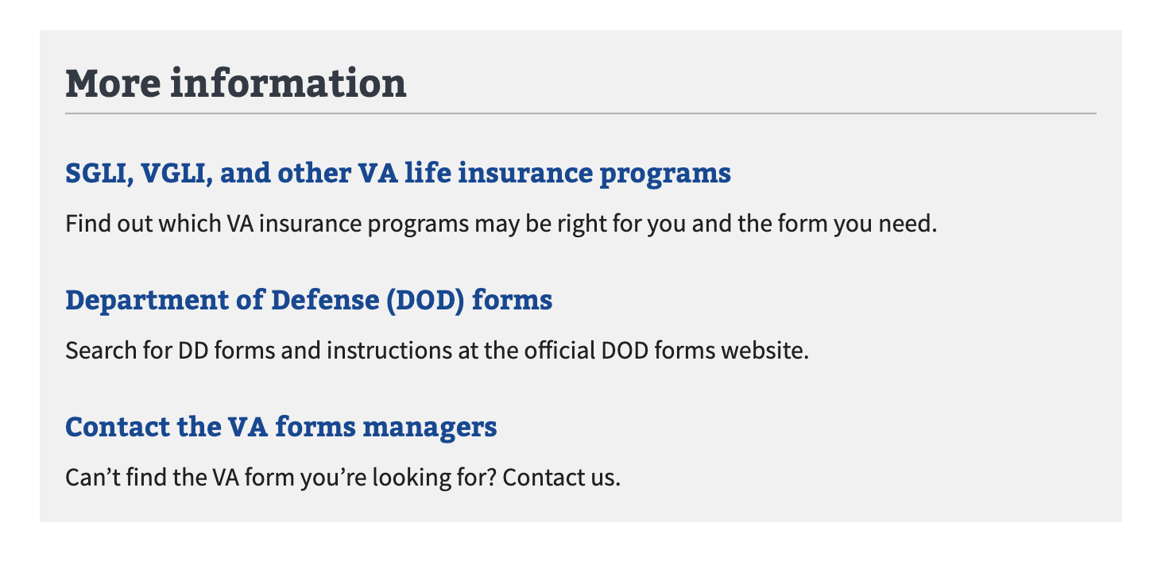
Find additional information outside VA
Find VA Forms - Search Product Guide

